Slide 1
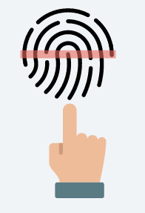
Decentralized Digital Identity:
The Elusive Key to Inclusive
Growth
Nathan Ming Kun Aw
Hyperledger Technical Ambassador
Hyperledger Speaker
SOURCE:
https://www.hyperledger.org/community/technical-ambassador
https://www.hyperledger.org/news/speakersbureau
https://sg.linkedin.com/in/awnathan
Notes:
Blockchain essentially a database, but traditional databases have central admins, which makes using them to house transaction data involving parties that don’t trust one another problematic and expensive. So, each entity maintains their own database, resulting in duplicate data and, if there are mistakes or malicious behavior, results in expensive and time consuming disputes over what the actual state of the truth is. This is particularly true when exchanging assets. And lots of different institutions recording different assets.

Slide 2



Nathan Ming Kun Aw
Hyperledger Technical Ambassador and Speaker with deep experience and specialties in Decentralized (Blockchain) Based Digital Identification
Worked in Multiple Fortune 100 companies
Presenter at the Decentralized Internet Infrastructure at the Internet Engineering Task Force (IETF)
World Renowned Blockchain Specialist, Speaker and an Fierce Advocate for Blockchain to Solve Real-world Problems (“Not another PoC” or “White Elephant”)

Slide 3
Problem Statement: Digital Chasm, Not Divide - Non Inclusive Growth
The Result
A challenge for the 1 billion people to access basic services — healthcare, education, financial and mobile services — and may miss out on important economic opportunities, such as participating in the digital economy or formal employment
Compromised Centralized ID Systems leading to privacy breaches leading to an erosion of trust in Digital ID and its systems thus perpetuating the digital chasm
The Situation
An estimated 1 billion (“1,000,000,000”) people globally face challenges in proving who they are because they lack official proof of their identity.
3.4 Billion People have ID but cannot use it on digital channels
Centralized Digital ID Systems can be weak, exclusionary, can go down and put people’s privacy at risk
SOURCE:
https://id4d.worldbank.org/sites/id4d.worldbank.org/files/2018_ID4D_Annual_Report.pdf
http://workspace.unpan.org/sites/Internet/Documents/Digital%20Identification_A%20Key%20to%20Inclusive%20Growth.pdf?Mobile=1&Source=%2Fsites%2FInternet%2F%5Flayouts%2Fmobile%2Fview%2Easpx%3FList%3D691145ee%252Dd828%252D42e1%252D80a4%252Dc007f54e9ee7%26View%3D0a4712bf%252De571%252D4b28%252D9bbc%252Ddd8086c05003%26ViewMode%3DDetail%26CurrentPage%3D1

Slide 4




What is Digital ID?
Unlike a paper-based ID such as most driver’s licenses and passports, a digital ID can be authenticated remotely over digital channels.
A digital ID could be issued by a national or local government, by a consortium of private or nonprofit organizations, or by an individual entity.
To perform digital authentication, it could be through biometric data to passwords, PINs, or smart devices and security tokens

Slide 5

Benefits of Digital ID (1/2)
Digital ID can promote increased and more inclusive access to education, healthcare, and labor markets; can aid safe migration; and can contribute to greater levels of civic participation.
Inclusion
Civic Participation

Slide 6
Benefits of Digital ID (2/2)
Inclusion
More increased inclusion, protection, civic participation, and transparency
In India, the Aadhaar program drastically reduced cost of
onboarding a customer; approximately 290 million Aadhaar linked bank accounts have been created
▪ Pakistan relied on its national biometric database after floods
drastically impacted millions to identity citizens eligible for
assistance based on their registered address
Civic Participation
Ability to participate in
political systems; improved equality
Estonia has over 30% of citizens voting online; of those, 20% said they would have not voted if unable to do so online
▪ Pakistan, with the use of strong biometrics, added 36 million new eligible voters

Slide 7
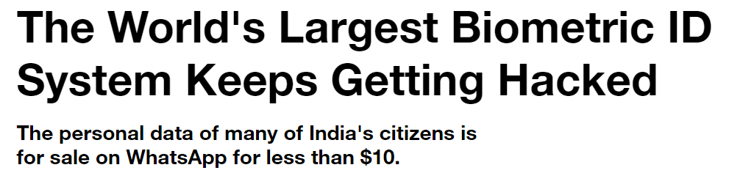
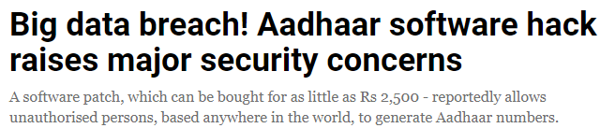
Challenges with Today’s Digital ID System
SOURCE:
https://www.vice.com/en_us/article/43q4jp/aadhaar-hack-insecure-biometric-id-system
https://www.huffingtonpost.in/2018/09/11/uidai-s-aadhaar-software-hacked-id-database-compromised-experts-confirm_a_23522472/
https://www.indiatimes.com/technology/news/your-worst-fears-are-realized-aadhaar-has-been-hacked-with-a-rs-2-500-software-patch-352859.html
https://www.businesstoday.in/current/economy-politics/aadhaar-software-hack-uidai-data-ghost-entries/story/282260.html

Slide 8
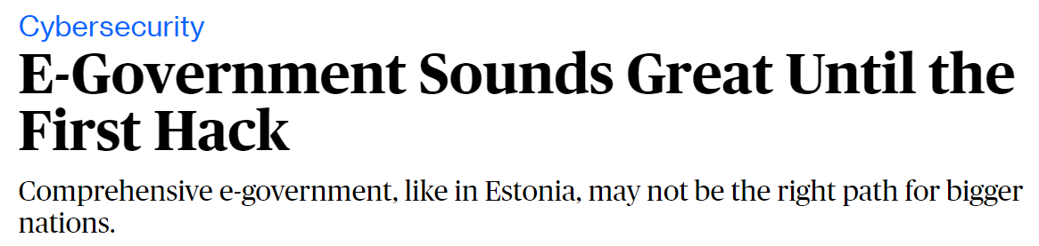
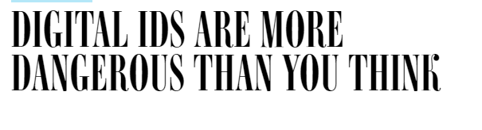
SOURCE:
https://www.bloomberg.com/opinion/articles/2017-11-21/e-government-sounds-great-until-the-first-hack
SOURCE:
https://www.wired.com/story/digital-ids-are-more-dangerous-than-you-think/
Security, Privacy and Trust
What is the missing element in these Digital ID Systems that are being implemented and rolled out?

Slide 9
Could Decentralized Digital Identity Be
the Missing Key to Unlock Inclusive Growth Through Trust that is Decentralized?

Slide 10
Overview of Hyperledger
Indy
Distributed ledger purpose-built for decentralized identity
Correlation-resistant by design
DIDs (Decentralized Identifiers) that are globally unique and resolvable (via a ledger) without requiring any centralized resolution authority
Pairwise Identifiers create secure, 1:1 relationships between any two entities
Verifiable Credentials in an interoperable format for exchange of digital identity attributes and relationships, currently in the standardization pipeline at the W3C
Zero Knowledge Proofs which prove that some or all of the data in a set of Claims is true without revealing any additional information, including the identity of the Prover
https://wiki.hyperledger.org/display/indy/Hyperledger+Indy
https://wiki.hyperledger.org/display/indy/Evernym+Sprint+Demos

Slide 11
Hyperledger Supports DIDs (Decentralized Identifiers)
Decentralized Identifiers (DIDs) are a new type of identifier for verifiable, "self-sovereign" digital identity. DIDs are fully under the control of the DID subject, independent from any centralized registry, identity provider, or certificate authority.
DIDs are URLs that relate a DID subject to means for trustable interactions with that subject. DIDs resolve to DID Documents — simple documents that describe how to use that specific DID.
Each DID Document may contain at least three things: proof purposes, verification methods, and service endpoints. Proof purposes are combined with verification methods to provide mechanisms for proving things. For example, a DID Document can specify that a particular verification method, such as a cryptographic public key or pseudonymous biometric protocol, can be used to verify a proof that was created for the purpose of authentication. Service endpoints enable trusted interactions with the DID controller.

Slide 12
Overview of Hyperledger
Aries
Specifically, it provides:
A blockchain interface layer (known as a resolver) for creating and signing blockchain transactions
A cryptographic wallet that can be used for secure storage of cryptographic secrets and other information (the secure storage tech, not a UI) used to build blockchain clients
An encrypted messaging system for allowing off-ledger interaction between those clients using multiple transport protocols.
An implementation of ZKP-capable W3C verifiable credentials using the ZKP primitives found in Ursa.
An implementation of the Decentralized Key Management System (DKMS) specification currently being incubated in Hyperledger Indy.
A mechanism to build higher-level protocols and API-like use cases based on the secure messaging functionality described earlier.
Infrastructure for blockchain-rooted, peer-to-peer interactions.
Provides a shared, reusable, interoperable tool kit designed for initiatives and solutions focused on creating, transmitting and storing verifiable digital credentials.

Slide 13
The Three Waves
Now to ~2025
Roll Out Centralized Digital ID Systems and/or leverage existing Digital ID Providers
2025 - ~2035
Decentralize Centralized Digital ID Systems and Digital ID Providers
2035 and Beyond
Fully Decentralized Digital ID Systems -- anytime and anywhere, within countries and across borders

Slide 14
The Target End State
A decentralized digital ID for all the citizens of the world whose identity is fully owned by him/her thereby fostering trust and narrowing the digital chasm
Notes:
https://www.microsoft.com/en-us/security/technology/own-your-identity

Slide 15
Concluding Thoughts
Are we in a Blockchain Winter? If we are, Decentralized Digital Identity can potentially take us out of this Winter into Spring.

Slide 16

Get Involved!
Questions around Hyperledger and its related projects, you can reach out to me at nathan.mk.aw@gmail.com
or connect with me at https://sg.linkedin.com/in/awnathan
Notes:
Call-to-action to website for more info rather than member calls

Slide 17
Sources/References
https://sg.linkedin.com/in/awnathan
https://about.me/mingkun.aw
https://datatracker.ietf.org/meeting/103/materials/slides-103-dinrg-decentralized-identity-01
https://datatracker.ietf.org/meeting/104/materials/slides-104-dinrg-byzantine-agreement-protocols-for-large-scale-decentralized-identity-management-01
https://github.com/nathanawmk
https://stackoverflow.com/users/8588369/nathan-aw
https://blockchain.ieee.org/technicalbriefs/editorial-board
https://bitcoinmagazine.com/authors/nathan-aw
https://bitcoinmagazine.com/articles/guest-post-understanding-limits-and-potential-blockchain-technology
https://www.hyperledger.org/blog/2017/12/05/developer-showcase-series-nathan-aw-ntt-data

